Slide 1
Based on the Commission Proposal for Horizon Europe, the common understanding between co-legislators and the Partial General Approach, both approved in April 2019

Slide 2
Our vision
A sustainable, fair and prosperous future for people and planet based on European values.
Tackling climate change (35 % budgetary target)
Helping to achieve Sustainable Development Goals
Boosting the Union's competitiveness and growth
Credits: https://www.un.org/sustainabledevelopment/sustainable-development-goals/
Notes:
Investing in research and innovation is investing in Europe’s future. It helps us to compete globally and preserve our unique social model and European way of life.
R&I improves the daily lives of millions of people here in Europe and around the world, helping to solve some of our biggest societal and generational challenges.
The Horizon Europe proposal significantly contributes to achieve the Commission's priorities and the global policy priorities.
This includes foremost the Sustainable Development Goals as well as the climate objectives in line with the Union's commitment to implement the Paris Agreement.
Regarding the latter the contribution expected from this programme is increased to 35% to reach the overall target of 25% of the Union expenditure.

Slide 3
Horizon Europe: Preliminary structure
Pillar 1
Excellent Science
Pillar 2
Global Challenges and European Industrial Competitiveness
Pillar 3
Innovative Europe
European Research Council
Health
Culture, Creativity and Inclusive Society
Civil Security for Society
Digital, Industry and Space
Climate, Energy and Mobility
Food, Bioeconomy, Natural Resources, Agriculture and Environment
European Innovation Council
Marie Skłodowska-Curie Actions
Clusters
European innovation
ecosystems
European Institute of Innovation and Technology
Research Infrastructures
Joint Research Centre
Widening Participation and Strengthening the European Research Area
Widening participation and spreading excellence
Reforming and Enhancing the European R&I system

Slide 4
Commission proposal for budget: €100 billion* (2021-2027)
* This envelope includes EUR 3.5 billion allocated under the InvestEU Fund.

Slide 5
Lessons Learned Key Novelties from Horizon 2020 Interim Evaluation in Horizon Europe
Support breakthrough innovation
European Innovation Council
Create more impact through mission-orientation and citizens' involvement
R&I Missions
Strengthen international cooperation
Extended association possibilities
Reinforce openness
Open science policy
Rationalise the funding landscape
New approach to Partnerships
Encourage participation
Spreading Excellence
Rules for participation: continuity and simplification

Slide 6
European Innovation Council
Support to innovations with breakthrough and disruptive nature and scale up potential that are too risky for private investors (70% of the budget earmarked for SMEs)
Helping innovators create markets of the future, leverage private finance, scale up their companies,
European Innovation Council – a one-stop-shop
Innovation centric, risk taking & agile, pro-active management and follow up
Two complementary instruments bridging the gap from idea to investable project
Pathfinder: grants
(from early technology to pre- commercial)
Accelerator: grants only & blended finance
(from pre-commercial to market & scale-up)

Slide 7
R&I Missions
R&I Missions
Relating EU's research and innovation better to society and citizens' needs; with strong visibility and impact
A mission is a portfolio of actions across disciplines intended to achieve a bold and inspirational and measurable goal within a set timeframe, with impact for society and policy making as well as relevance for a significant part of the European population and wide range of European citizens.
Horizon Europe defines mission characteristics and elements of governance, and 5 missions areas.
Specific missions will be programmed within the Global Challenges and European Industrial Competitiveness pillar (drawing on inputs from other pillars)

Slide 8
Adaptation to climate change, including societal transformation
Healthy oceans, seas, coastal and inland waters
Mission areas
Cancer
Climate-neutral and smart cities
Soil health and food

Slide 9
New approach to European Partnerships
New generation of objective-driven and more ambitious partnerships in support of agreed EU policy objectives
Key features
Simple architecture and toolbox
Coherent life-cycle approach
Strategic orientation
Co-programmed
Based on Memoranda of Understanding / contractual arrangements; implemented independently by the partners and by Horizon Europe
Co-funded
Based on a joint programme agreed and implemented by partners; commitment of partners for financial and in-kind contributions
Institutionalised
Based on long-term dimension and need for high integration; partnerships based on Articles 185 / 187 of TFEU and the EIT-Regulation supported by Horizon Europe

Slide 10
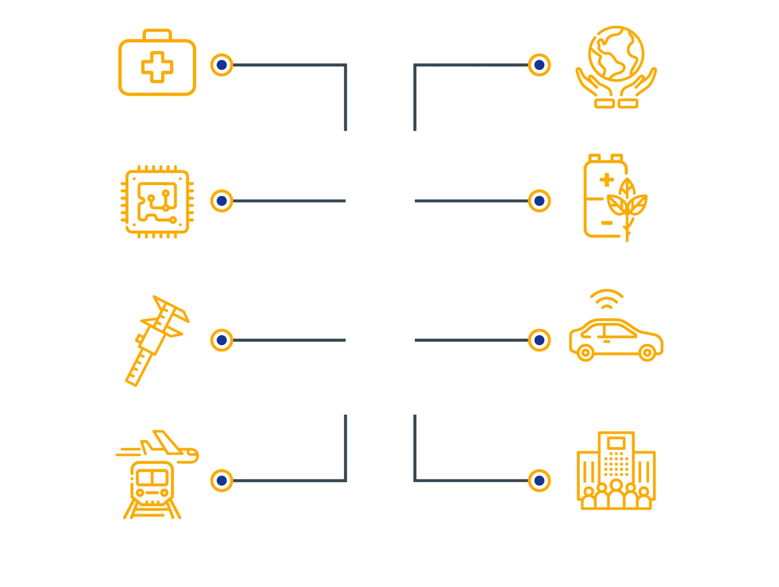
Sustainable bio-based solutions
Health innovations
Hydrogen and sustainable energy storage
Key digital and enabling technologies
Areas for possible Institutionalised European partnerships (based on Article 185/7 TFEU)
Clean, connected mobility
Metrology
EU air traffic, aviation and rail
Innovative SMEs

Slide 11
Roadmap for the preparation of European Partnerships
Currently ongoing:
Further consultations on the Orientations towards the Strategic Plan
Ongoing Impact Assessment work for Article 185/7 candidates
Further elaboration of proposals for Partnerships in co-creation between partners and Commissions services
Key elements for the next steps
Finalisation of Strategic Plan Horizon Europe
Outcome of the Impact Assessment work
Progress on MFF negotiations
Need for clarity: For which European Partnerships candidates will the new Commission adopt legislative proposals (Article 185/7), which candidates should be implemented as co-programmed/co-funded partnerships and included in the Strategic Plan
Without political agreement on budgetary envelope for Horizon Europe: No budget allocation to candidates for European Partnerships, no COM proposals for Article 185/7 initiatives

Slide 12
Widening participation/spreading excellence
National Contact Point (NCP) Support
Pre-proposal checks
15 Member States and 9 outermost regions eligible for coordinators
At least 3.3% budget
Recognition of participation
EXCELLENCE
Foster participation
Facilitate collaborative links
Contribute to reducing R&I divide
Match-making
Hop-on
Excellence initiatives
Brain circulation
Teaming
Twinning
ERA-Chairs
COST

Slide 13
Simple and fit for purpose rules
Further alignment to the Financial Regulation
Increased use of simplified forms of grants where appropriate (building on the H2020 lump sum pilot experience)
Broader acceptance of usual cost accounting practices
Enhanced cross-reliance on audits benefiting beneficiaries taking part in several Union programmes
Attractive H2020 funding model, including up to 100% funding rate of direct costs
Single set of rules principle
while ensuring continuity and consistency for beneficiaries by maintaining

Slide 14
Horizon Europe – implementation, prioritisation and impact

Slide 15
Strategic Plan for implementing Horizon Europe
The Strategic Plan (new implementing act by the Commission) will prepare the content in the work programmes and calls for proposals for the first four years
Strategic orientation for R&I support, expected impacts
Partnerships and missions
Areas for international cooperation
Issues such as:
Balance between research and innovation
Social Sciences and Humanities
Key Enabling Technologies and strategic value chains
Gender
Ethics and integrity
Dissemination and exploitation

Slide 16
Strategic plan gives direction to the work programme
Horizon Europe legislative package
Strategic Plan 2021-2024
Work programme 2021-2022
Calls for proposals
Main Features
Early involvement and extensive exchanges with Member States
Extensive exchanges with the European Parliament
Consultations with stakeholders and public at large

Slide 17
Steps towards the first Horizon Europe work programme
Summer
2019
Early involvement and exchanges with Member States, consultation with stakeholders and the public at large Establishment of Mission Boards
Autumn-winter 2019/2020
Co-creation at Research & Innovation Days 24 – 26 September. Extensive exchanges with the new European Parliament.
Establishment of new Commission - envisaged endorsement of Strategic Plan
2020
Drafting of first Horizon Europe Work Programme on the basis of the Strategic Plan
2021
Start of Horizon Europe

Slide 18
Key impact pathways to track progress
1. Creating high-quality new knowledge
Scientific
Impact
2. Strengthening human capital in R&I
3. Fostering diffusion of knowledge and Open Science
4. Addressing EU policy priorities & global challenges through R&I
Societal Impact
5. Delivering benefits & impact via R&I missions
6. Strengthening the uptake of R&I in society
7. Generating innovation-based growth
Economic
Impact
8. Creating more and better jobs
9. Leveraging investments in R&I

Slide 19
Implementation strategy
The Implementation Strategy will be an essential component for delivering the objectives of Horizon Europe, in practice;
It will embrace all the processes involved in running calls, selecting proposals and managing projects, with joined-up systems and common principles.
It will ensure that the new programme is managed according to highest standards, maximizing the impact of every Euro spent;
The strategy will build on successful experience to date, but taking account of lessons learned, and also adapted to the new features of Horizon Europe.

Slide 20
Review of changes needed for Horizon Europe
Submission & evaluation
Model Grant Agreement
Dissemination & exploitation
Reporting & data collection (also for impact pathways)
Control Strategy
Extended use of simplified costs
Outreach
Digital transformation
International cooperation
Synergies
Model Grant Agreement preparation
Full analysis of the entire project life cycle
Consultation with external stakeholders/MS expert group
Internal consultation
October 2018
2019

Slide 21
Implementation strategy – Ongoing final steps
Ongoing consultations
Consolidating and co-drafting of the Implementation Strategy
Key milestones
R&I Days 24-26 September in Brussels
National and Regional Stakeholder events
Co-design exercise through web survey, closed 4 October (report available)
Member States experts group meetings on Model Grant Agreement in July and November 2019

Slide 22
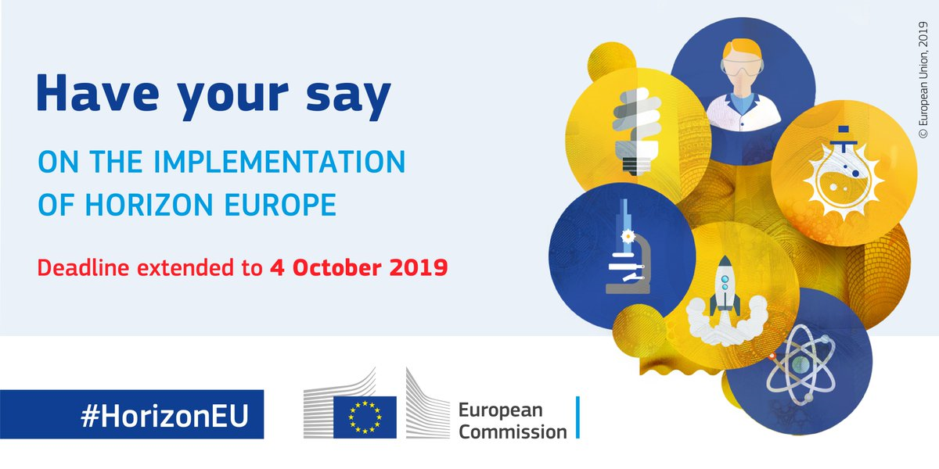
Co-design exercise on Horizon Europe Implementation Strategy
The survey covers the entire project life cycle, from organisation of calls, proposal submission and evaluation up to efficient reporting and exploitation of results.

Slide 23
Feedback from the Horizon Europe Co design – Implementation (online consultation / R&I Days)
Key messages
General acknowledgement of simplifications introduced in H2020, considered as good starting point.
Clear endorsement of the continuity in the implementation from Horizon 2020 to Horizon Europe. The approach “evolution, not revolution” taken by the Commission for the rules for participation and, by extension in a wider sense, to the implementation of the new programme is appreciated by respondents

Slide 24
Feedback from the Horizon Europe Co design – Implementation (online consultation / R&I Days)
Some key messages per business processes
Work programme: feedback underlines convenience to move towards less prescriptive topics and less complex calls.
Submission process: respondents consider substantial margin for simplification, suggest shortening the proposals, simplifying the templates and removing non-core R&I parts.
Evaluation: request of improving evaluation feedback, more extensive use of two-stage evaluation, introducing interviews with proposers, improving the quality of experts involved, or involving civil society actors in the evaluation process.

Slide 25
Feedback from the Horizon Europe Co design – Implementation (online consultation / R&I Days)
Some key messages per business processes
Project management: need to improve IT systems and the Funding and Tenders Portal, simplify the amendment process, improve automatic notifications, provide a channel for continuous feedback. Furthermore, some respondents highlight that individual POs should not set stricter requirements than the standard ones.
Audits & control: Audits & control: enhanced cross-reliance on audits and assessments, also through system and process audits, leading to further reduction of audit burden.

Slide 26
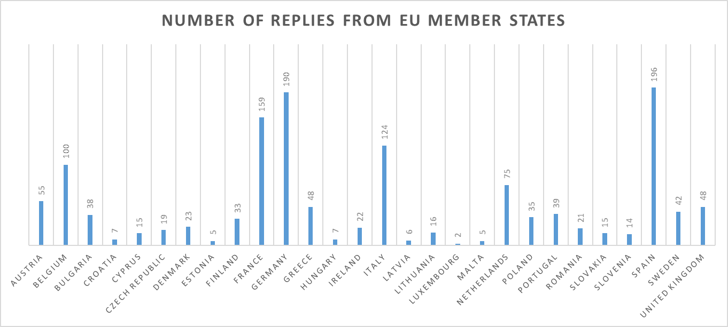
Bulgarian and Romanian replies to online consultation
Number of answers: 38 from Bulgaria and 21 from Romania out of 1549 replies
Feedback from Bulgaria and Romania in line with overall feedback

Slide 27
Bulgarian and Romanian replies to online consultation Breakdown by category
Higher number of respondents that have not participated/submitted a proposal before
Type of organisations represented:
34% universities and research organisations
32% business and industries
22% NGOs
7% public authorities, 5% other
Interest in the Framework Programme:
42% are currently participating in a project funded by a EU R&I framework programme
34% have never participated/submitted a proposal before but are interested in the programme
24% have participated/submitted a proposal before

Slide 28
Thank you!
#HorizonEU
http://ec.europa.eu/horizon-europe
© European Union, 2019. | Images source: © darkovujic, #82863476; © Konovalov Pavel, #109031193; 2018. Fotolia.com

